Slide 1
Ashton Kutcher
Boris Bernát
8.B

Slide 2
Content
1. General informations
2. Early life
3. Relationships

Slide 3
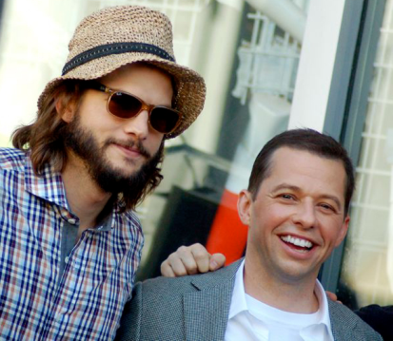
General informations
His originally name is Christopher Ashton Kutcher he was born on 7th February 1978 in Cedar Rapids, U.S.A. He is american actor, producer, and model. He is known for his portrayal of Michael Kelso in the Fox sitcom That '70s Show. He also created, produced, and hosted Punk'd and had lead roles in the Hollywood films: Jobs, Dude, Where's My Car?, Just Married, The Butterfly Effect, The Guardian and What Happens in Vegas. Since 2011, Kutcher has starred in the sitcom Two and a Half Men, he portrayaled Walden Schmidt.

Slide 4
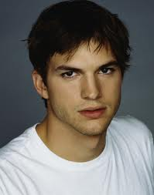
Early life
He lived on farm so he have not a lot of money.
He studied biochemistry and he needed money so he worked as janitor Cereal threshold in the fabric. The local finder of talents found him and Ashton has removed to the New York. He became famaous in retroserial That´s 70´s Show. Two years later in year 2000 he got role in the film Where's My Car? One year later he got role in the next film Texas rangers. His popularity has gone up.

Slide 5
Relationships
He was in relationship whit Demi Moore. They married on September 24, 2005. Wedding was with close friends and family. They had divorce On November 27, 2013. Now he is alone.

Slide 6
Thanks for your attention

